Slide 1
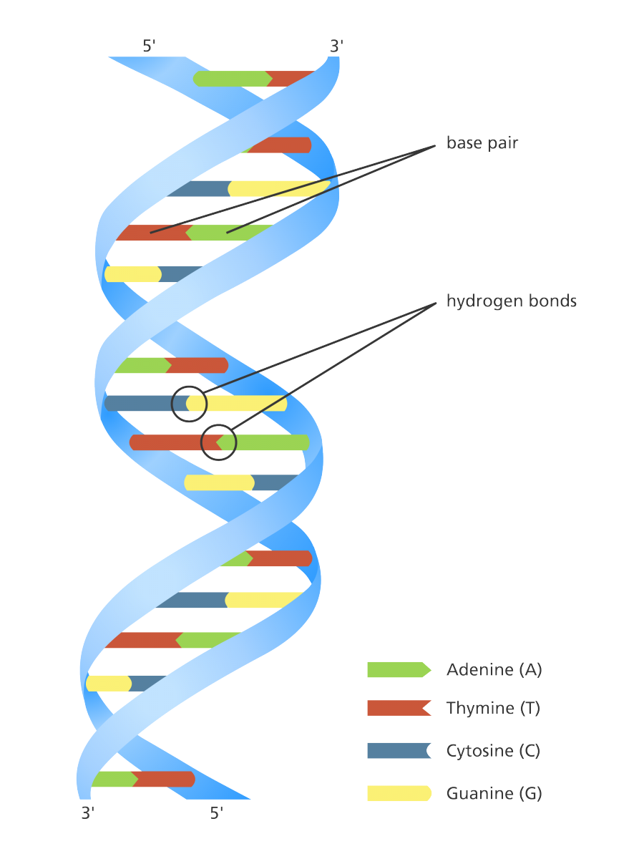
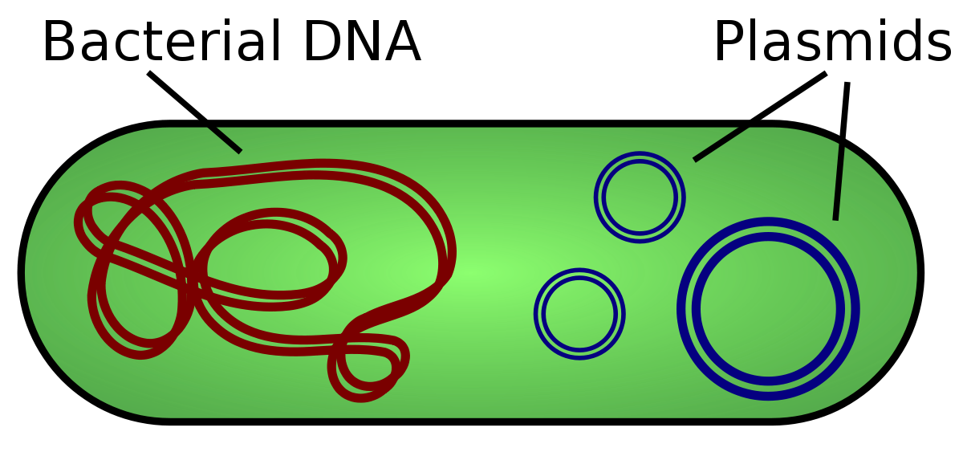
SACF Molecular Cloning Project
Tyler Lee
8/26/2022
Don’t mind the images here.

Slide 2
Purpose of SACF Internship
To gain research experience. This means:
Learning how to ask a question, conduct an experiment to answer the question, analyze results and make a reasonable conclusion based on the results
This will be done through the molecular cloning and the side experiment project.

Slide 3
TABLE OF CONTENTS
01
02
03
04
Molecular Cloning Background
What molecular cloning is. Process behind it
Molecular Cloning Purpose
Why we do molecular cloning
Experimental Process
What we did during the experiment
Experimental Conclusion
What can be concluded

Slide 4
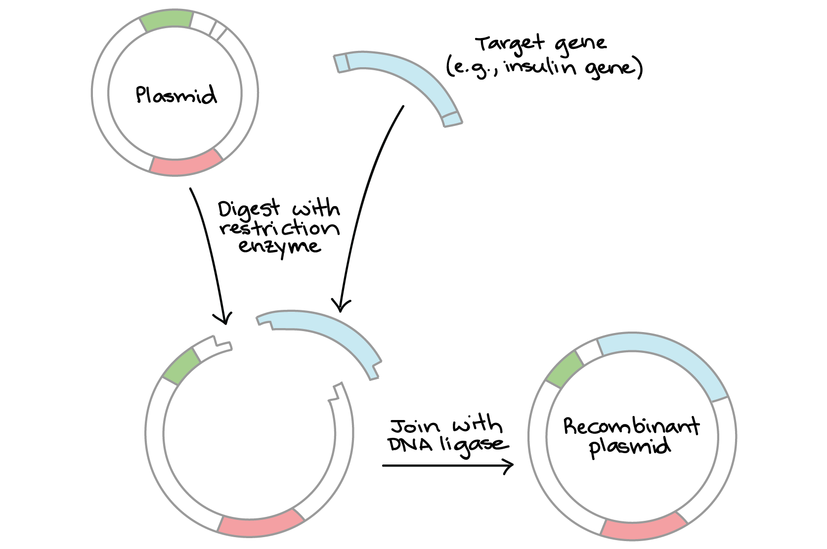
01
Molecular Cloning
This is pretty cool.

Slide 5
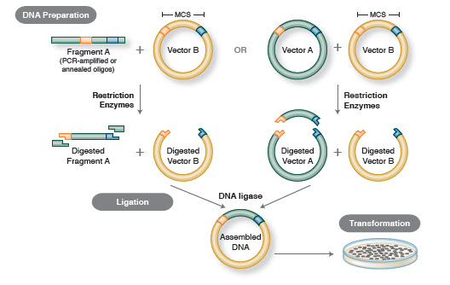
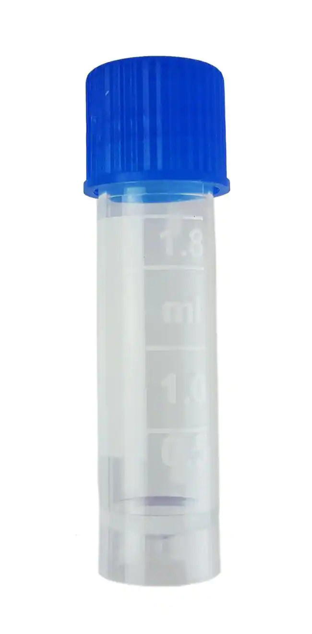
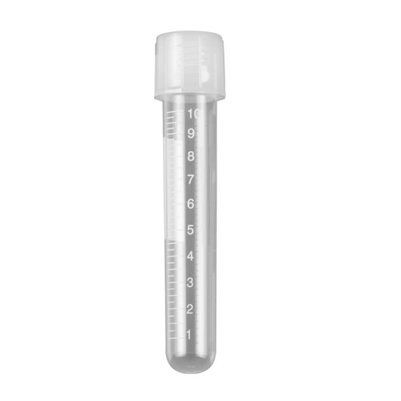
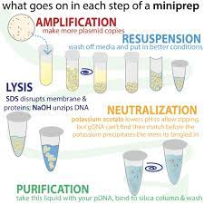
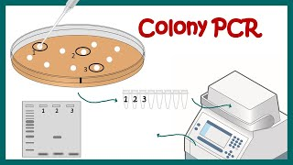
Images to explain Molecular Cloning
Molecular Cloning is a set of methods where we create recombinant DNA and replicate it.

Slide 6
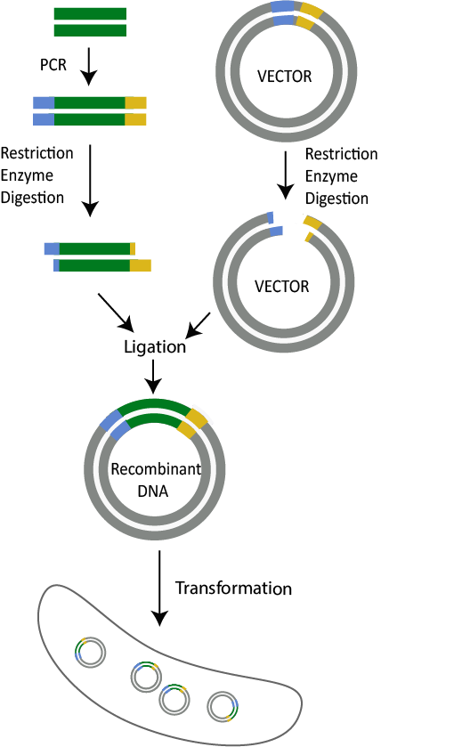
Molecular Cloning Procedure
Insert preparation: Amplify the insert by PCR and digest it
Vector Preparation: Digest the vector plasmid and purify the fragment
Vector + Insert = Wanted Cloned plasmid
Transformation: Introduced ligated DNA into bacteria. Grow the bacteria in Agar plate with antibiotic.

Slide 7
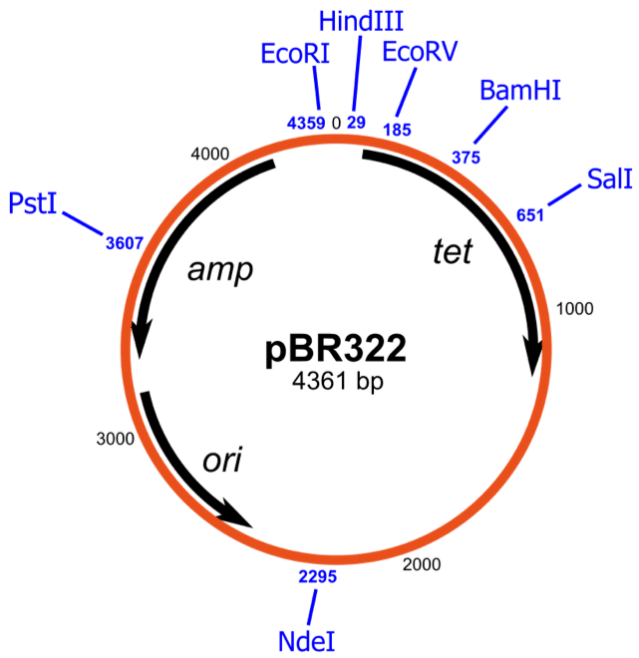
Molecular Cloning Procedure 2
Pick a colony from the plate, inoculate it.
After inoculation, extract the DNA from bacteria. This is done by a miniprep. (In our case)
Perform diagnostic digestion. This checks kilobase length of insert (if there is one) and successfulness.
Plasmid that has nothing to do with the project.

Slide 8
02
The Purpose of Molecular Cloning

Slide 9
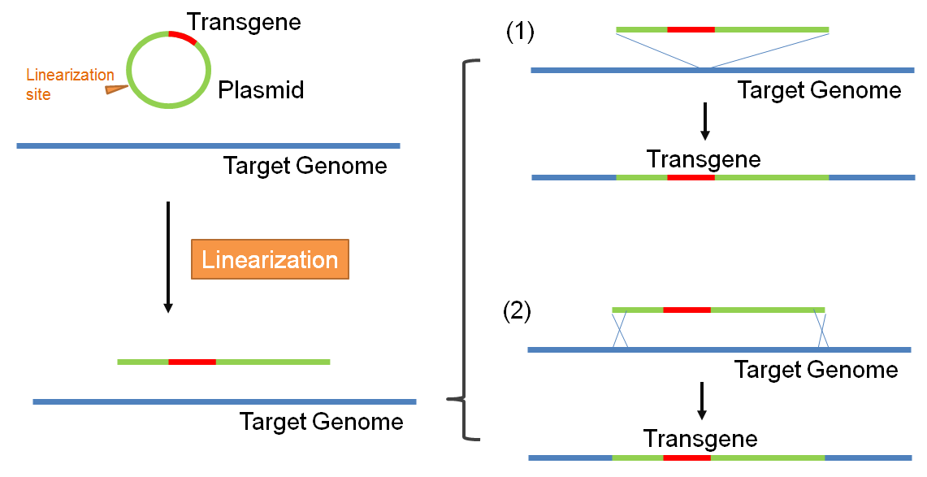
Molecular General Cloning Purpose
What we did in this entire process was that we made and replicated a transgene.
A transgene is a gene that is that can be introduced into the genome of another organism and then expressed.
We also modified the transgene to contain certain genes that we want expressed.
This image shows the cloned plasmid being implemented into a genome.

Slide 10
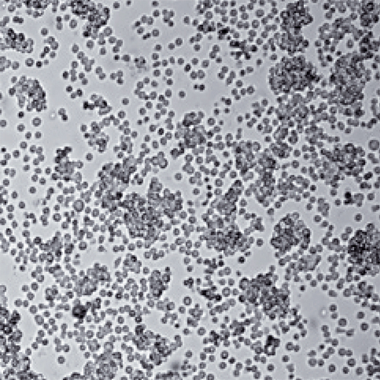
Molecular Cloning Purpose of this project
For this project, we are simply cloning RFP gene sequence, red fluorescent protein, mkate2.
This RFP will be expressed into HEK cells via transient transfection, to show activity in the plasmid.
Eventually, this RFP will then be inserted into tumor target cells, which are then labeled.

Slide 11
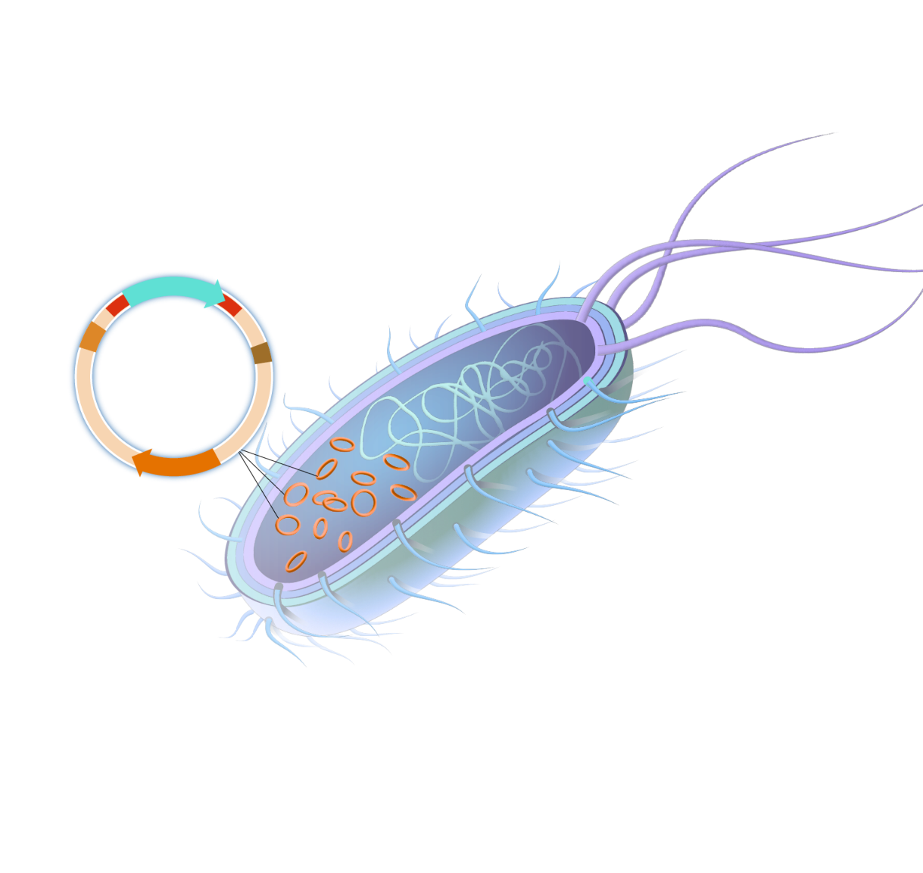
03
Experimental Process

Slide 12
Vector and Insert Prep
Insert goes through a gel to check the size after PCR.
PCR products are digested with EcoR1 and BamH1
Vector plasmid is digested with EcoR1 and BamH1. Ready to be purified after excision.
0.8kB

Slide 13
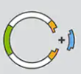
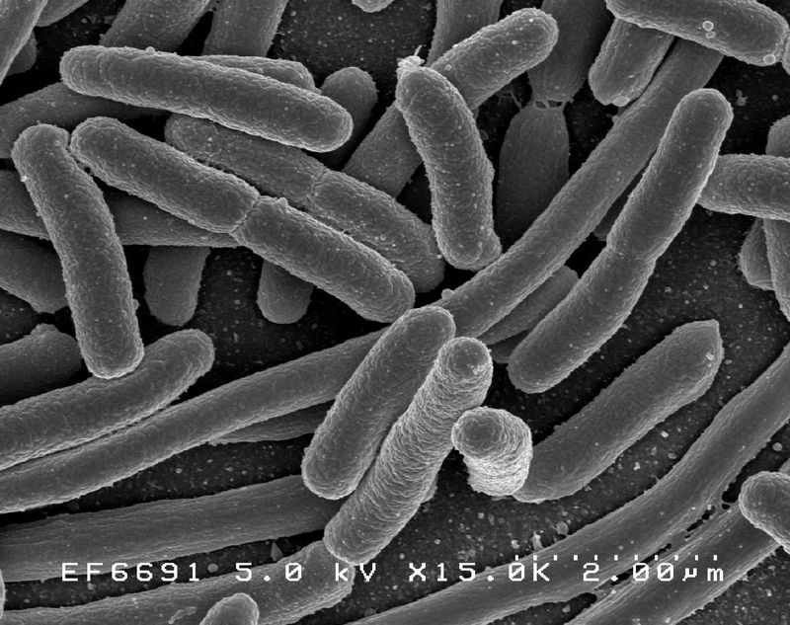
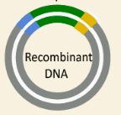
What we did with the plasmids.
Combined Product
Our insert and Vector being combined
Into the RIGHT competence cells.

Slide 14
Side Experiment: Most Effective Competence Cells
Batch 1: Old Stbl3 Cells
Batch 2: New Stbl3 Cells
Batch 3: NEB Cells
Control
Experimental

Slide 15
Side Experiment Conclusion
Based on the amount of colonies that grew on each plate:
Batch 2 Competence cells are the most efficient. We will be using these cells for the transformation of our ligated plasmids.
200
# of Colonies
B1
B2
B3

Slide 16
Results from the Transformation
We see that the plate with our ligated sample based on the fact that the plate with the ligated plasmid grew while the other didn’t
Insert and Backbone
Just Backbone
We pick out 3 colones from T2. We will call them O1, O2, and O3.

Slide 17
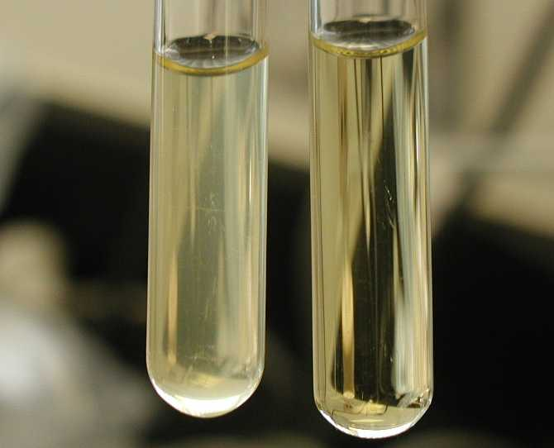
Plasmid extraction
O1, O2, O3 Inoculated colonies
Inoculated colonies have their plasmids extracted.

Slide 18
How to determine success cloning
A diagnostic digestion is ran with the ligated plasmids and it is done through the gel. We ran a positive control and negative control to determine success.
Result: Lanes with the red line are a success based on their length. Their inserts match with the wanted kilobase length. The second one does not match the length and is not taken for inoculation.
Lanes are in the order (Left to right): Ladder, empty, O1, O2, O3

Slide 19
04
Experimental Conclusion
How it all turned out.

Slide 20
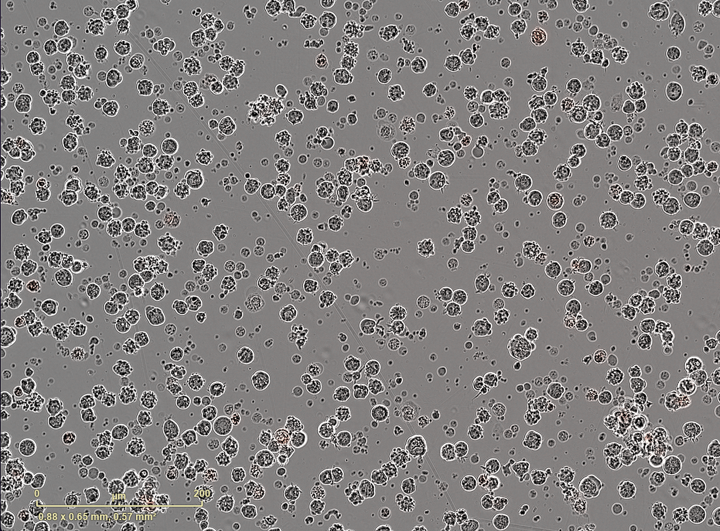
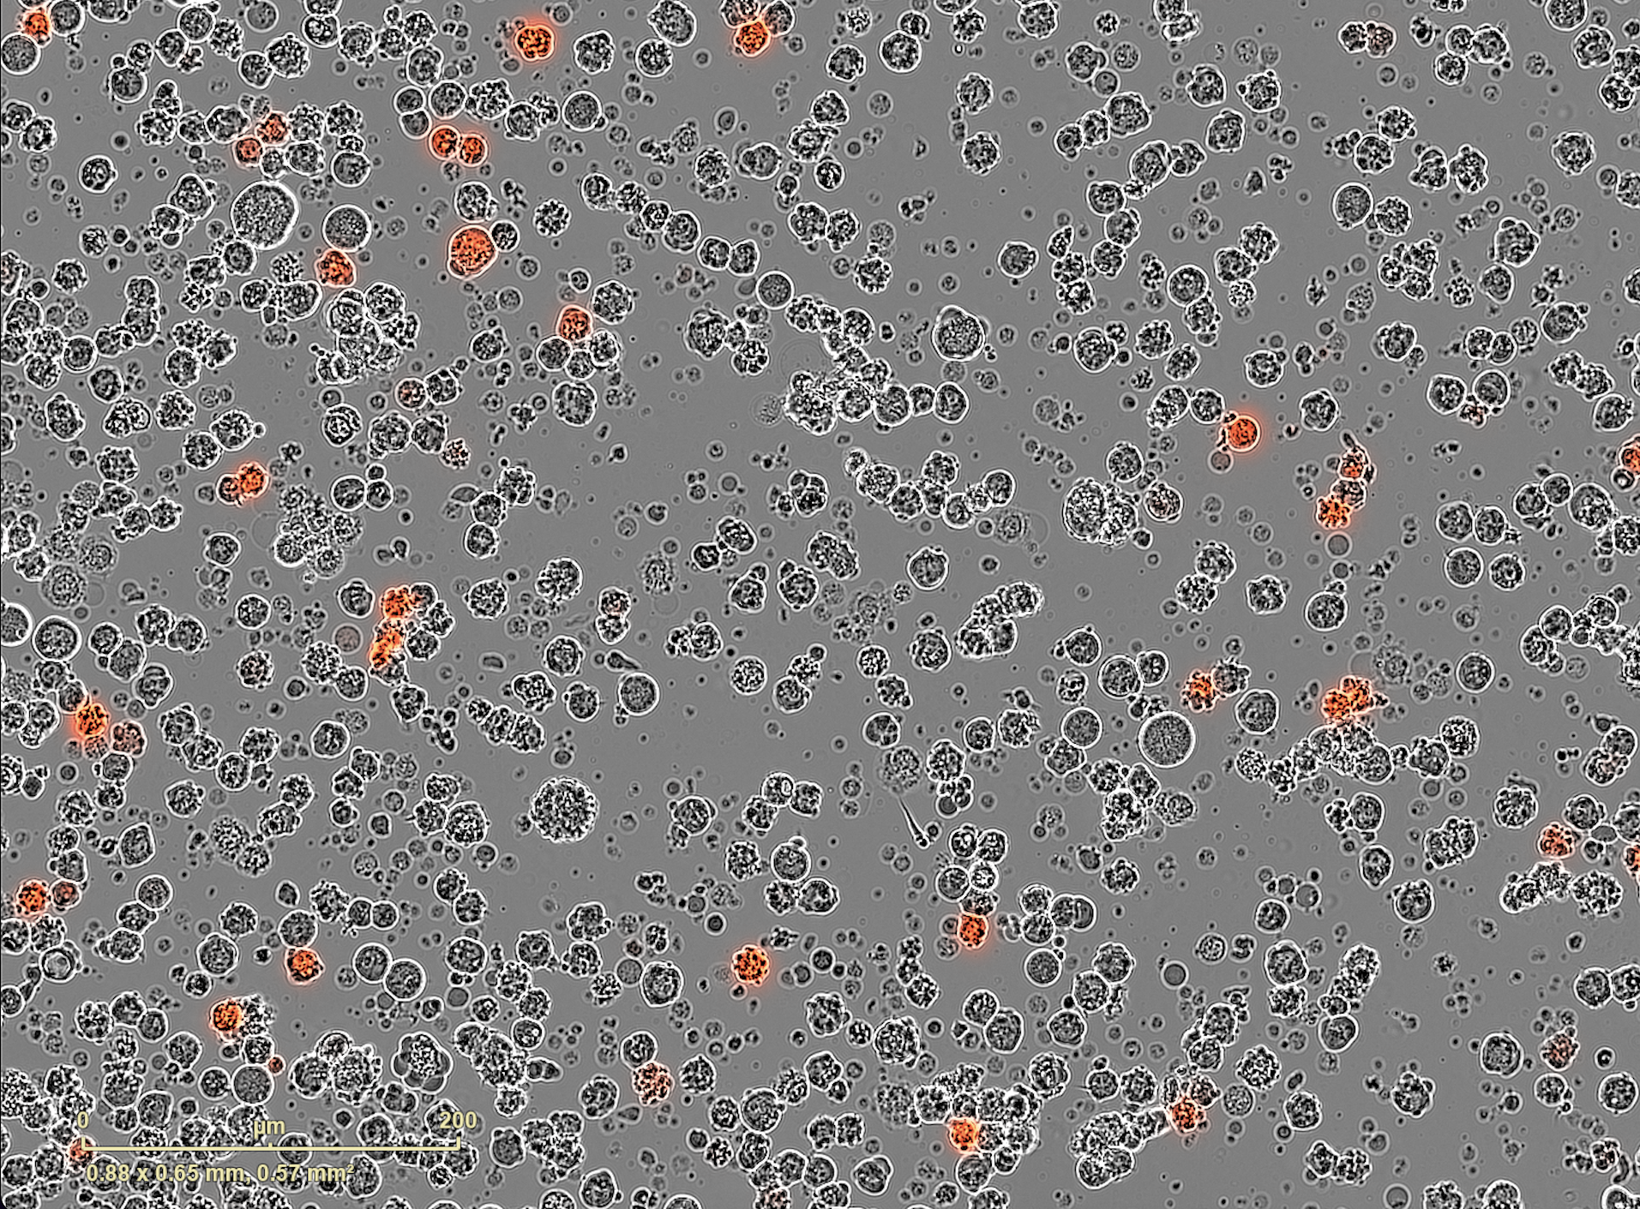
Molecular Cloning Conclusion
Based on the images to the right, successful recombination plasmids, which express mkate2 (RFP), have been generated. They are expressed in HEK cells and they light up in red in the imagery.

Slide 21
Thank You!
Credits of the slide theme is for Slide2go.

