Slide 1
Summer Student Chat
2023

Slide 2
Introduction
Major: Nutritional Biochemistry
Minor: Sports Medicine, Dance
Masters: Biology
JD: Patent Law
Notes:
Startups: Law, Business, Science
Bartending
Networking
Stationary / Business Cards

Slide 3
Types of Intellectual Property
Copyrights
Trademarks
Trade Secrets
Patents

Slide 4
Patents
Exclusive right granted for an invention
Right to decide how - or whether - the invention can be used by others
Requirement of Public Disclosure
3 Types: Utility, Design, Plant
Notes:
Utility patents may be granted to anyone who invents or discovers any new and useful process, machine, article of manufacture, or compositions of matters, or any new useful improvement thereof. By far, most patent applications filed at the USPTO are utility applications.
Design patents may be granted to anyone who invents a new, original, and ornamental design for an article of manufacture.
Plant patents may be granted to anyone who invents or discovers and asexually reproduces any distinct and new variety of plant.

Slide 5
Patent Prosecution
Patent Litigation
Patent Licensing

Slide 6
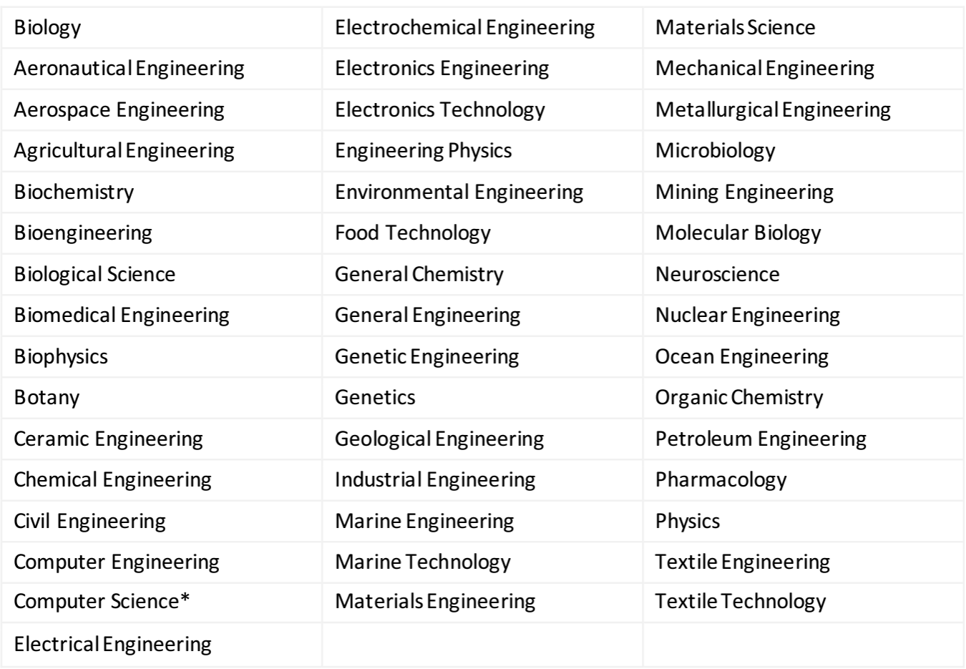

Slide 7
Patent Prosecution
Filing Date / Priority Date
Provisional / Non-Provisional Patent
Prior Art
Patent Cooperation Treaty (PCT) – 154 Contracting States
Information Disclosure Statement (IDS)
Publication
Office Action (Final and Non-Final)
Examiner Interview
Appeals / Continuation
Patent Trial and Appeal Board (PTAB)
Notice of Allowance
Maintenance (3, 7, 11 years after issue)

Slide 8
Patent Rejections Under 35 U.S.C.
101
Patent Ineligibility or Lack of Utility
102
Lack of Novelty
103
Obviousness
112
Lack of Adequate Description
Process, Machine, Article of Manufacture, Composition of Matter
NOT Abstract Idea, Law of Nature, Natural Phenomenon

Slide 9
Copyrights
The rights that creators have over their literary and artistic works
Includes books, music, paintings, sculpture, films, computer programs, databases, advertisements, maps, and technical drawings
Originality required, no mere compilation (modicum of creativity)
Automatic, beyond life of author
Notes:
A compilation is not copyrightable per se, but is copyrightable only if its facts have been "selected, coordinated, or arranged in such a way that the resulting work as a whole constitutes an original work of authorship.”
If you have registered within three months of the work’s publication date or before the infringement occurs, there is a legal presumption that your copyright is valid. Ordinarily, you have to prove actual damages to recover in a copyright lawsuit, but if the work was registered before the infringement, you can recover statutory damages and possibly attorneys’ fees without proving the damages. Statutory damages are awarded in an amount up to $150,000.

Slide 10
Trademarks / Trade Dress
An image capable of distinguishing the goods or services of one enterprise from those of other enterprises
Indefinite with continued maintenance
Notes:
You become a trademark owner as soon as you start using your trademark with your goods or services. You establish rights in your trademark by using it, but those rights are limited, and they only apply to the geographic area in which you’re providing your goods or services. If you want stronger, nationwide rights, you’ll need to apply to register your trademark with us.
You’re not required to register your trademark. However, a registered trademark provides broader rights and protections than an unregistered one.
For example, you use a logo as a trademark for the handmade jewelry you sell at a local farmer’s market. As your business grows and you expand online, you might want more protection for your trademark and decide to apply for federal registration. Registering your trademark with uspto means that you create nationwide rights in your trademark.
A trademark:
Identifies the source of your goods or services.
Provides legal protection for your brand.
Helps you guard against counterfeiting and fraud.
A common misconception is that having a trademark means you legally own a particular word or phrase and can prevent others from using it. However, you don’t have rights to the word or phrase in general, only to how that word or phrase is used with your specific goods or services.
For example, let's say you use a logo as a trademark for your small woodworking business to identify and distinguish your goods or services from others in the woodworking field. This doesn't mean you can stop others from using a similar logo for non-woodworking related goods or services.

Slide 11
Trade Secrets
Confidential information which may be sold or licensed
Protected via honest commercial practice
Unauthorized acquisition, use or disclosure of secret information in a manner contrary to honest commercial practices by others is regarded as an unfair practice and a violation of the trade secret protection.
Commercially valuable because it is secret
Known only to a limited group of persons, and
Reasonable steps taken to keep it secret
Notes:
In general, any confidential business information which provides an enterprise a competitive edge and is unknown to others may be protected as a trade secret. Trade secrets encompass both technical information, such as information concerning manufacturing processes, pharmaceutical test data, designs and drawings of computer programs, and commercial information, such as distribution methods, list of suppliers and clients, and advertising strategies.
A trade secret may be also made up of a combination of elements, each of which by itself is in the public domain, but where the combination, which is kept secret, provides a competitive advantage.
Other examples of information that may be protected by trade secrets include financial information, formulas and recipes and source codes.
Depending on the legal system, the legal protection of trade secrets forms part of the general concept of protection against unfair competition or is based on specific provisions or case law on the protection of confidential information.
While a final determination of whether trade secret protection is violated or not depends on the circumstances of each individual case, in general, unfair practices in respect of secret information include industrial or commercial espionage, breach of contract and breach of confidence.
A trade secret owner, however, cannot stop others from using the same technical or commercial information, if they acquired or developed such information independently by themselves through their own R&D, reverse engineering or marketing analysis, etc. Since trade secrets are not made public, unlike patents, they do not provide “defensive” protection, as being prior art. For example, if a specific process of producing Compound X has been protected by a trade secret, someone else can obtain a patent or a utility model on the same invention, if the inventor arrived at that invention independently.

Slide 12
Thanks for Listening!

