Slide 1
2023 Summer Program Lecture -
Bioinformatics 101
General background
DNA/RNA: sequence of nucleotides (deoxy/ribonucleic acid)
Gene: a fragment of DNA transcribed to produce a functional RNA, either protein-coding or noncoding.
Protein: sequence of amino acids (primary structure);
secondary structure (helix and sheet);
tertiary structure (3D)
Cell: the basic structural and functional unit of life forms.
Cellular/Molecular Pathway: series of actions among molecules in a cell that leads to a certain end point or cell function.

Slide 2
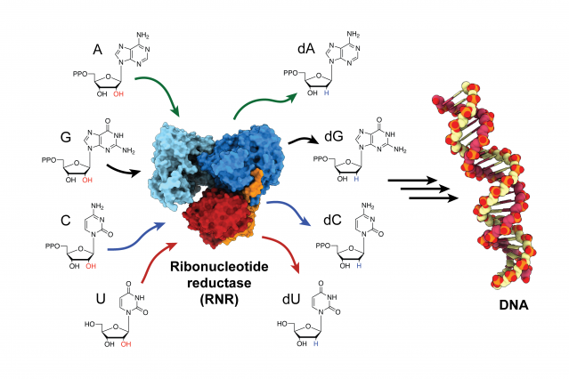
DNA/RNA: nucleotides (deoxy/ribonucleic acid)
nucleus
RNA
Cytosol
Ribonucleotide Reductase (RNR)
Kang G, et al. Science. 2020;368(6489):424

Slide 3
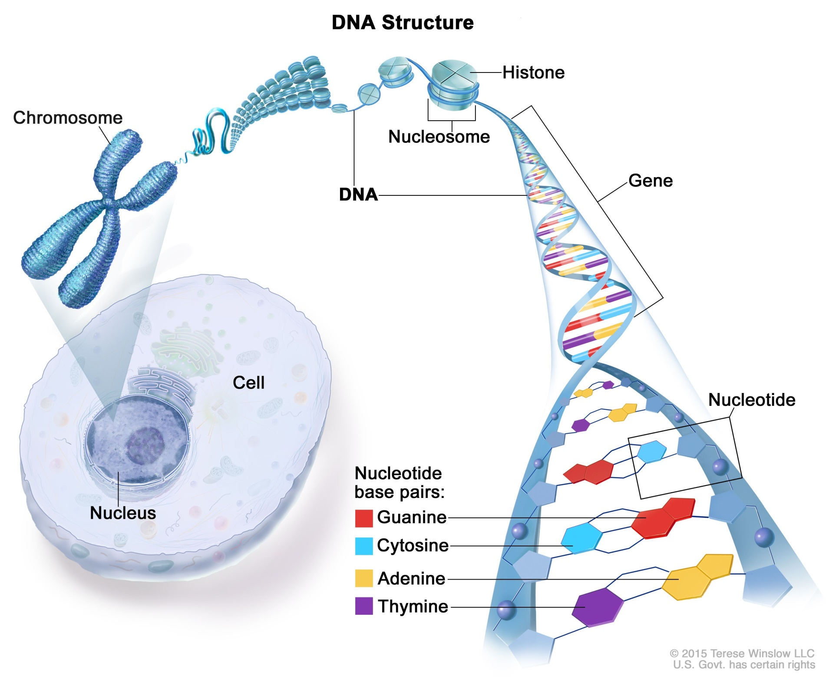
Gene: a fragment of DNA transcribed to produce a functional RNA

Slide 4
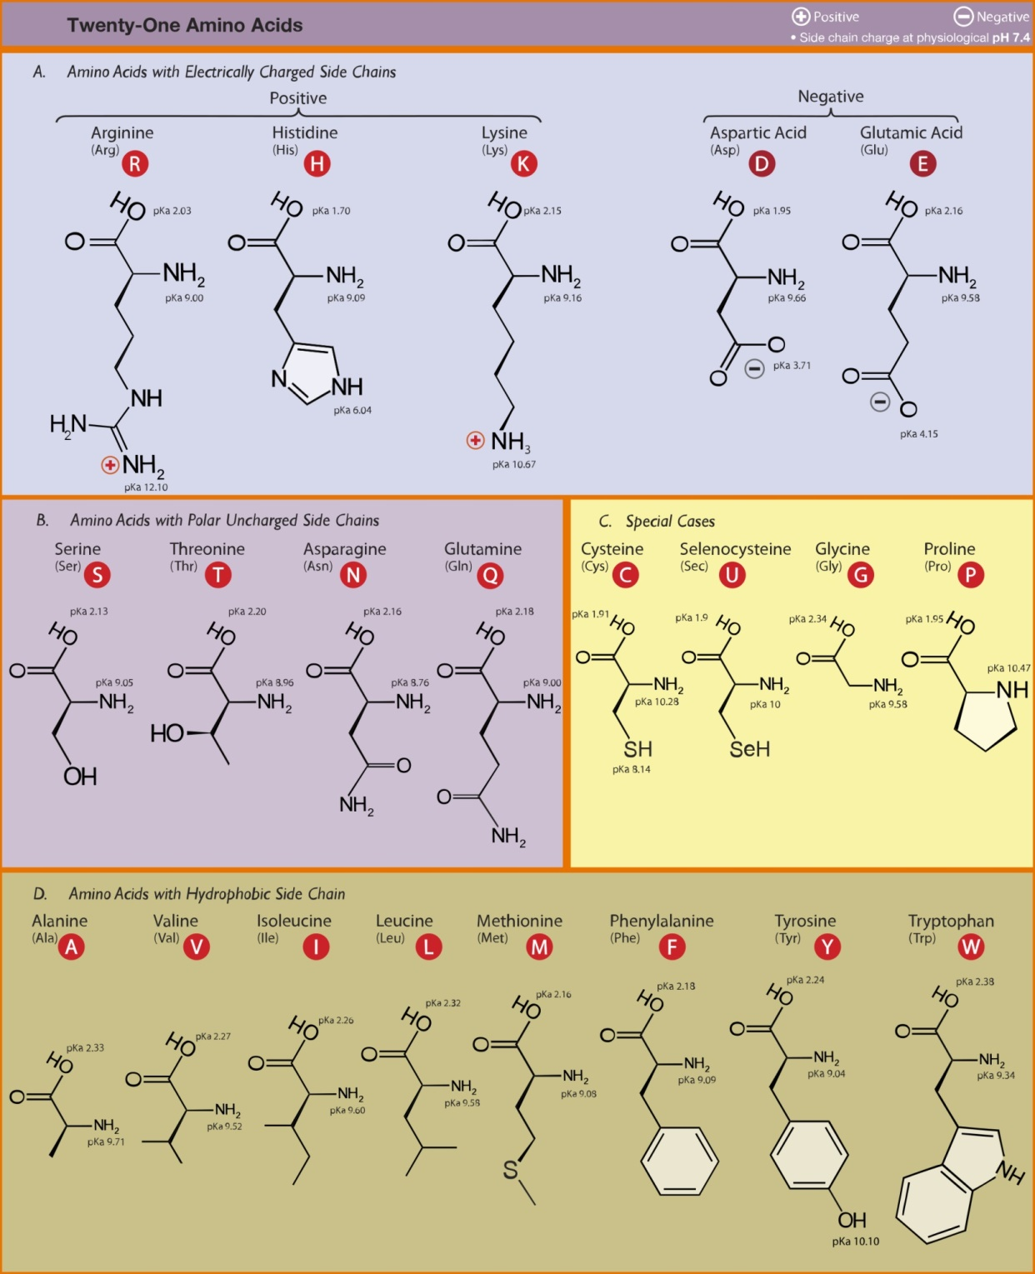
Protein: sequence of amino acids

Slide 5
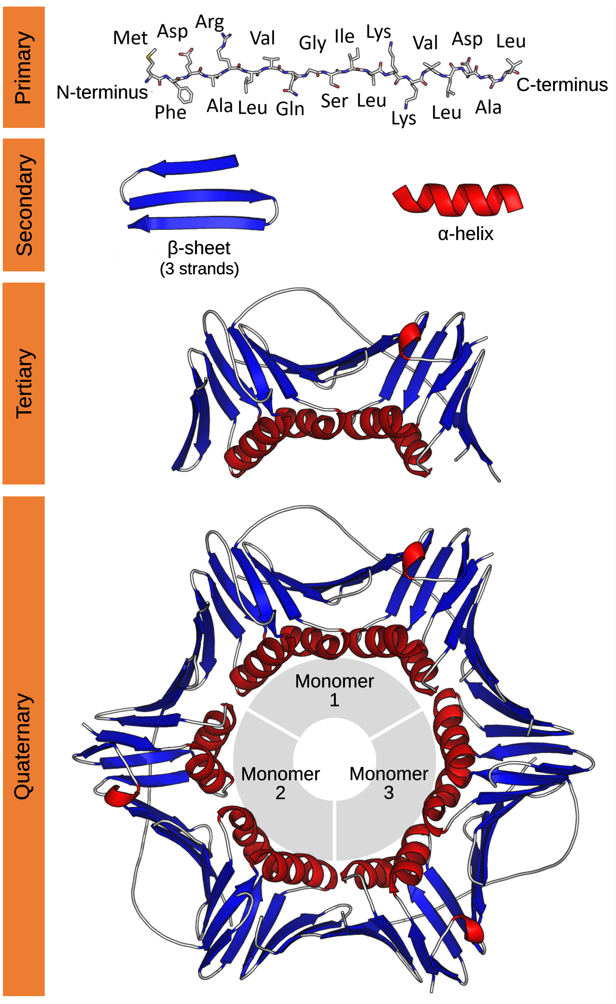
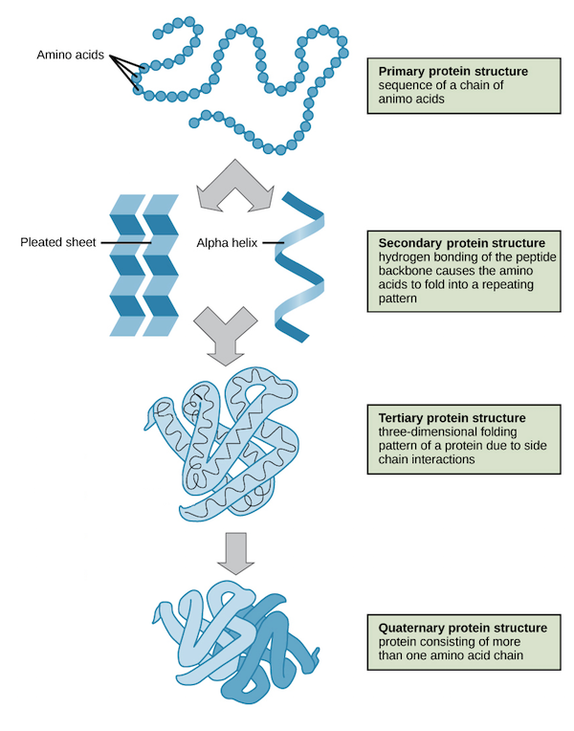
Protein Structure

Slide 6
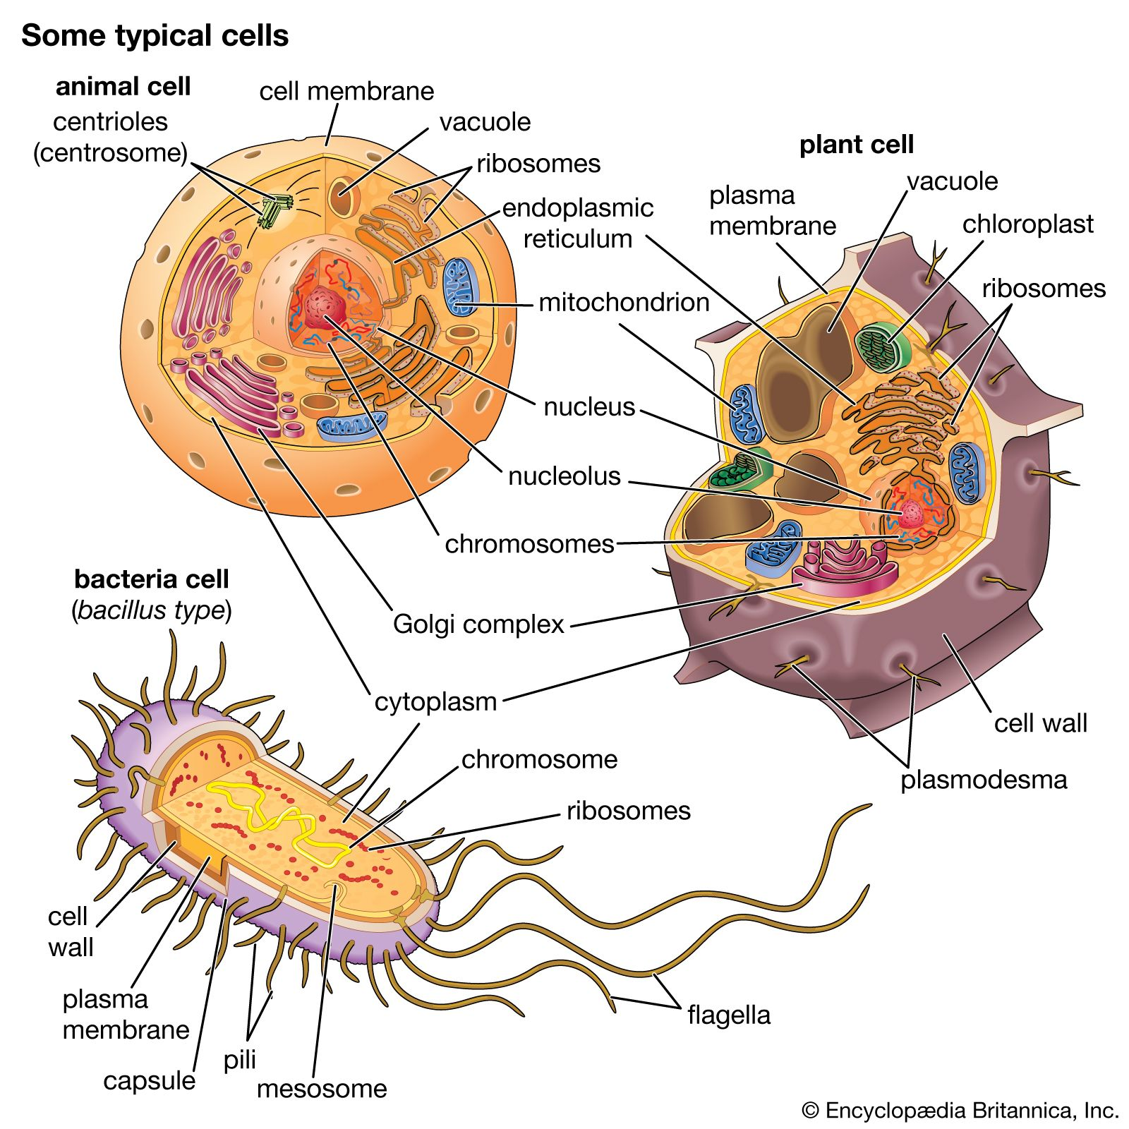

Slide 7
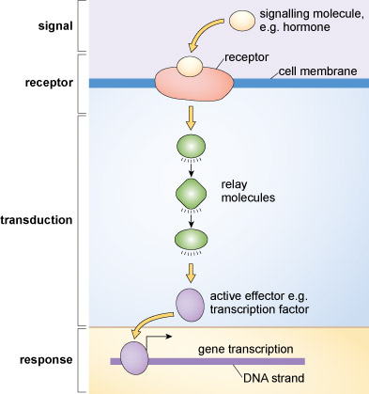
General principles of cellular communication

Slide 8
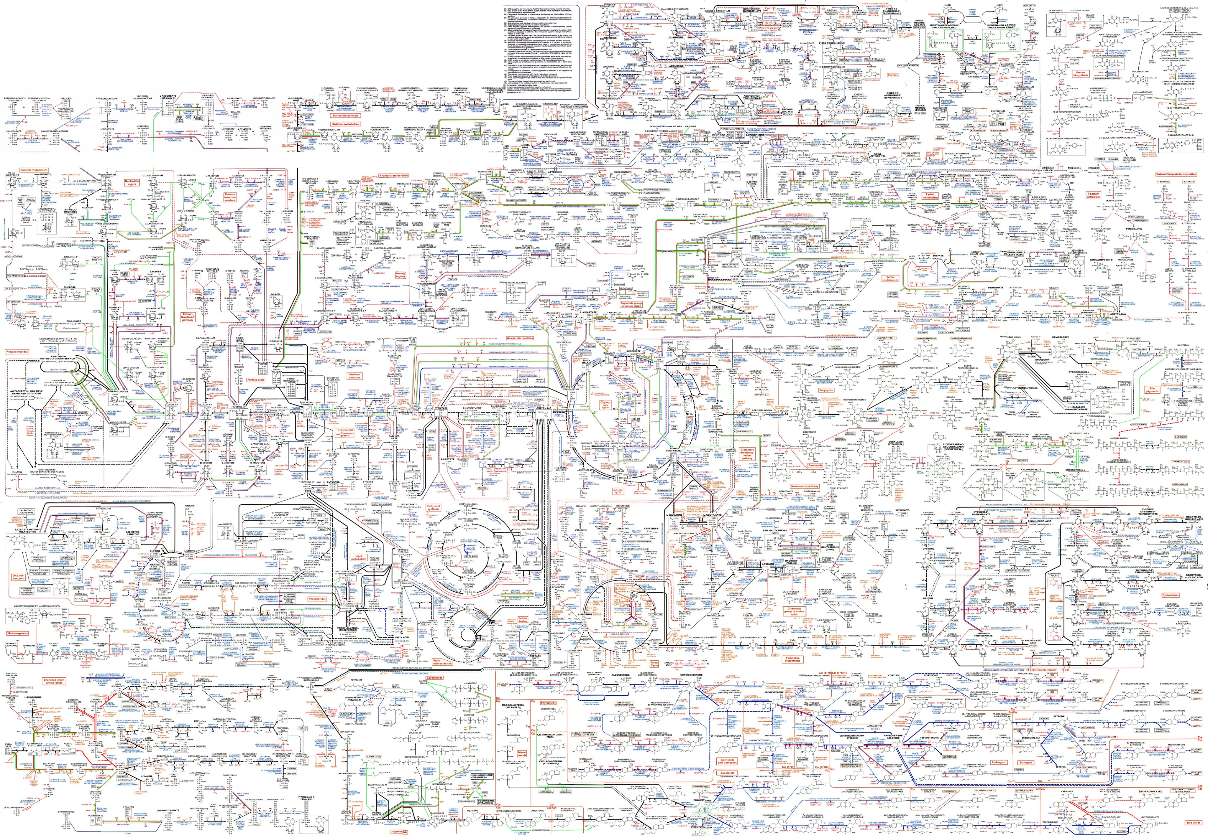
Map of the Known Human Metabolic Pathways

Slide 9
1. Informatics and Bioinformatics (NCBI)
Chemical compound database
DNA/RNA – Blast
Gene – Genebank
Genetics & medicine – ClinVar
Sequence analysis – flu virus (covid19)
Protein – protein database (sequence)
Protein structure – PDB
Protein visualization – Cn3D
Literature - pubmed
2. Other resources
Google Scholar
UniProt
Protein Data Bank (PDB)

Slide 10
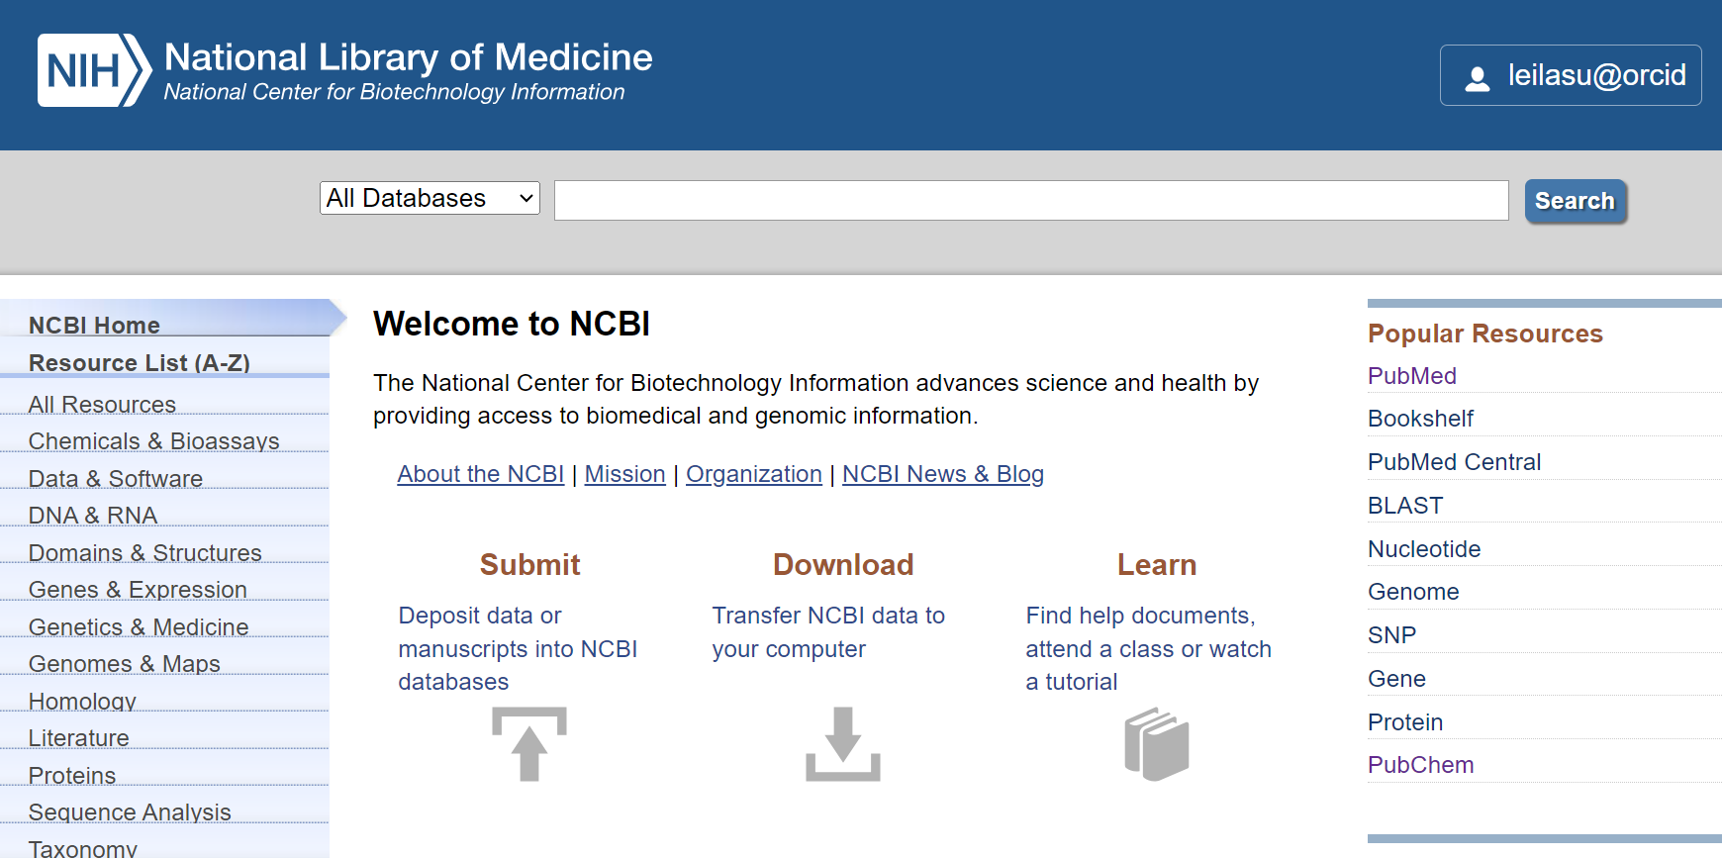
NCBI: National Center for Biotechnology Information
https://www.ncbi.nlm.nih.gov/

Slide 11
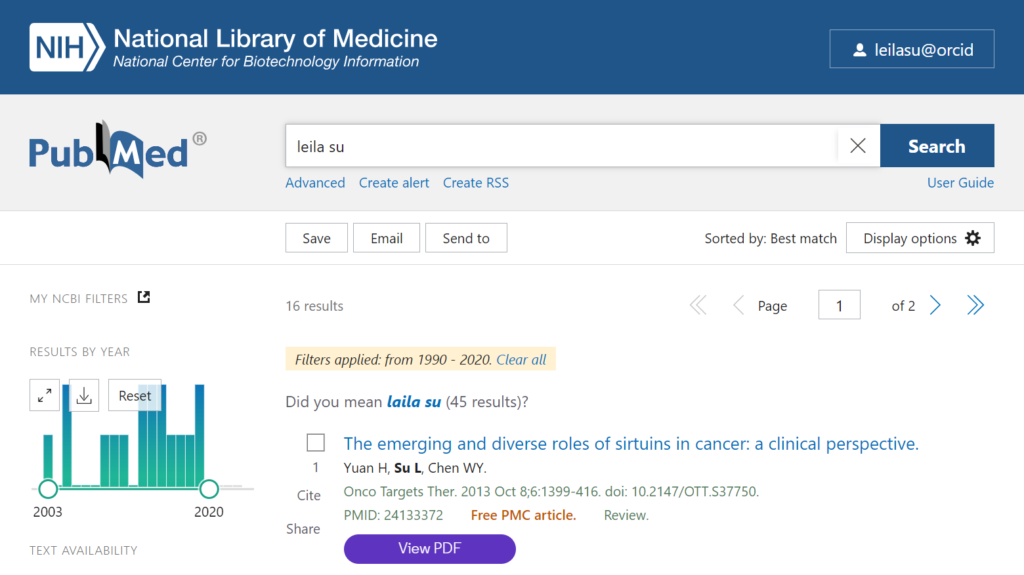
https://pubmed.ncbi.nlm.nih.gov

Slide 12
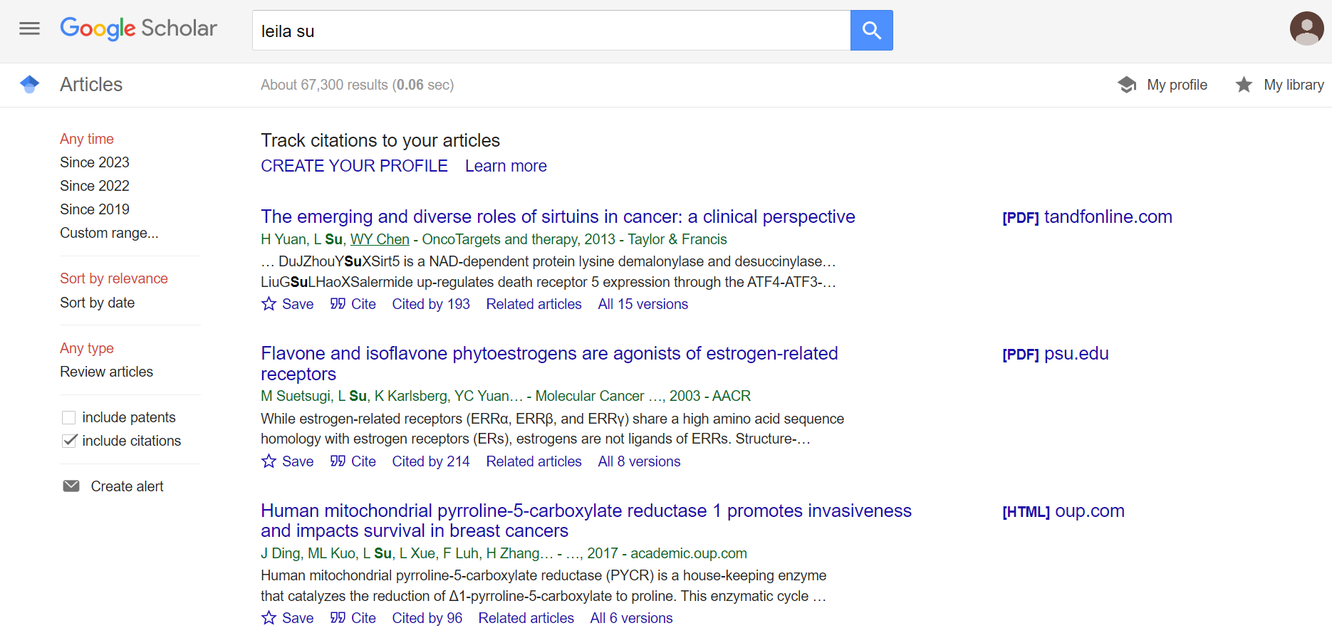
https://scholar.google.com/

Slide 13
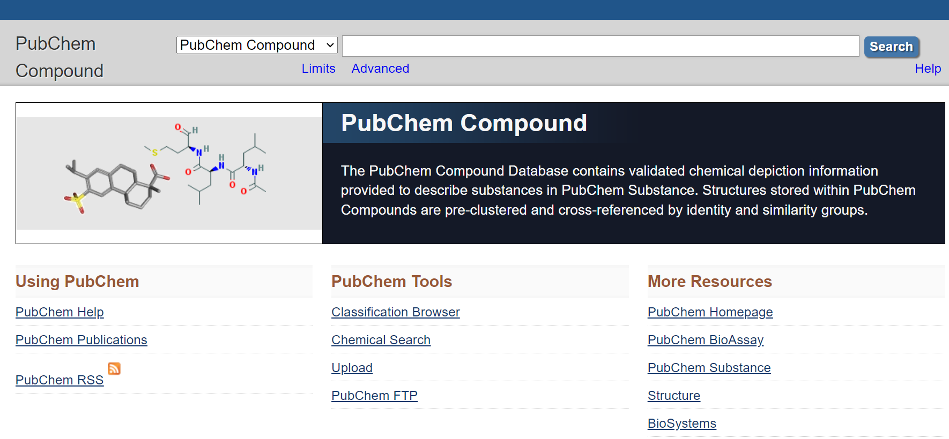
https://www.ncbi.nlm.nih.gov/pccompound

Slide 14
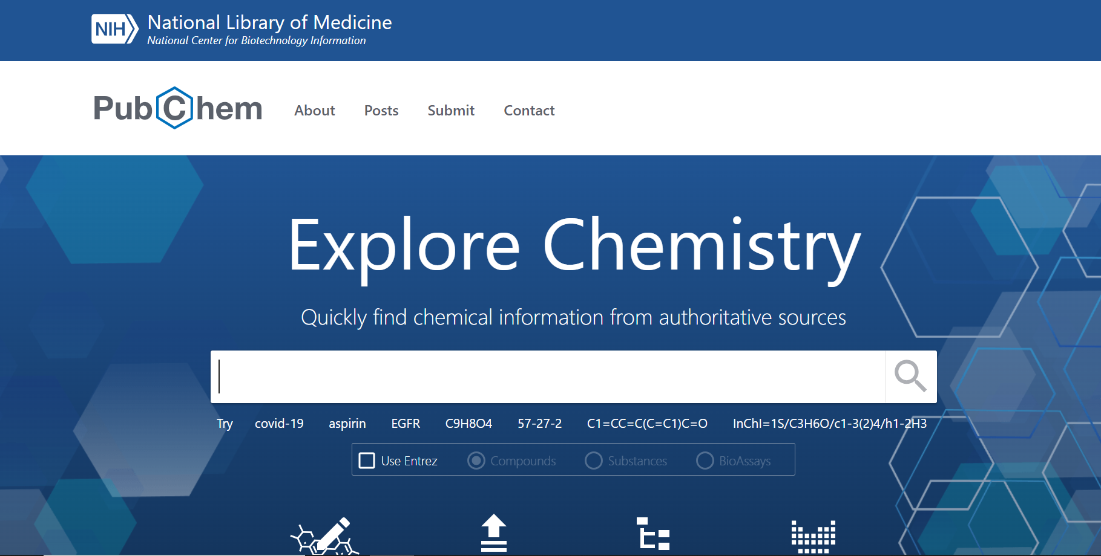
https://pubchem.ncbi.nlm.nih.gov/

Slide 15
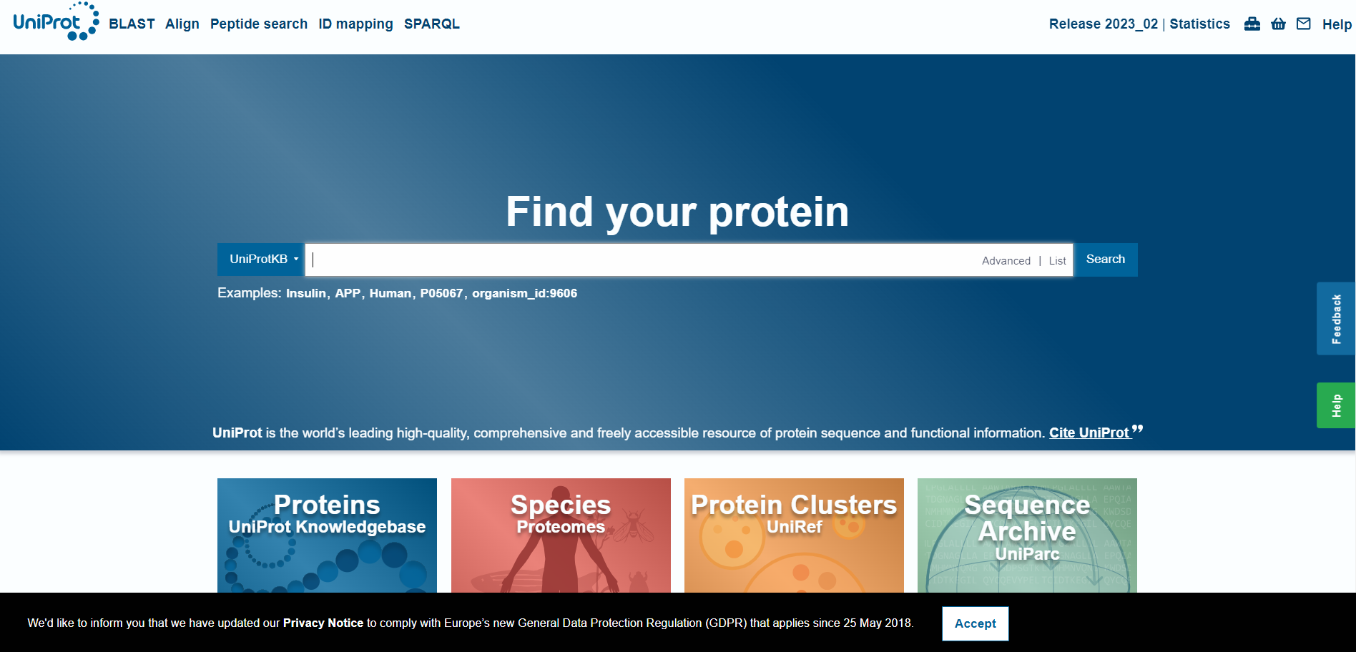
https://www.uniprot.org/

Slide 16
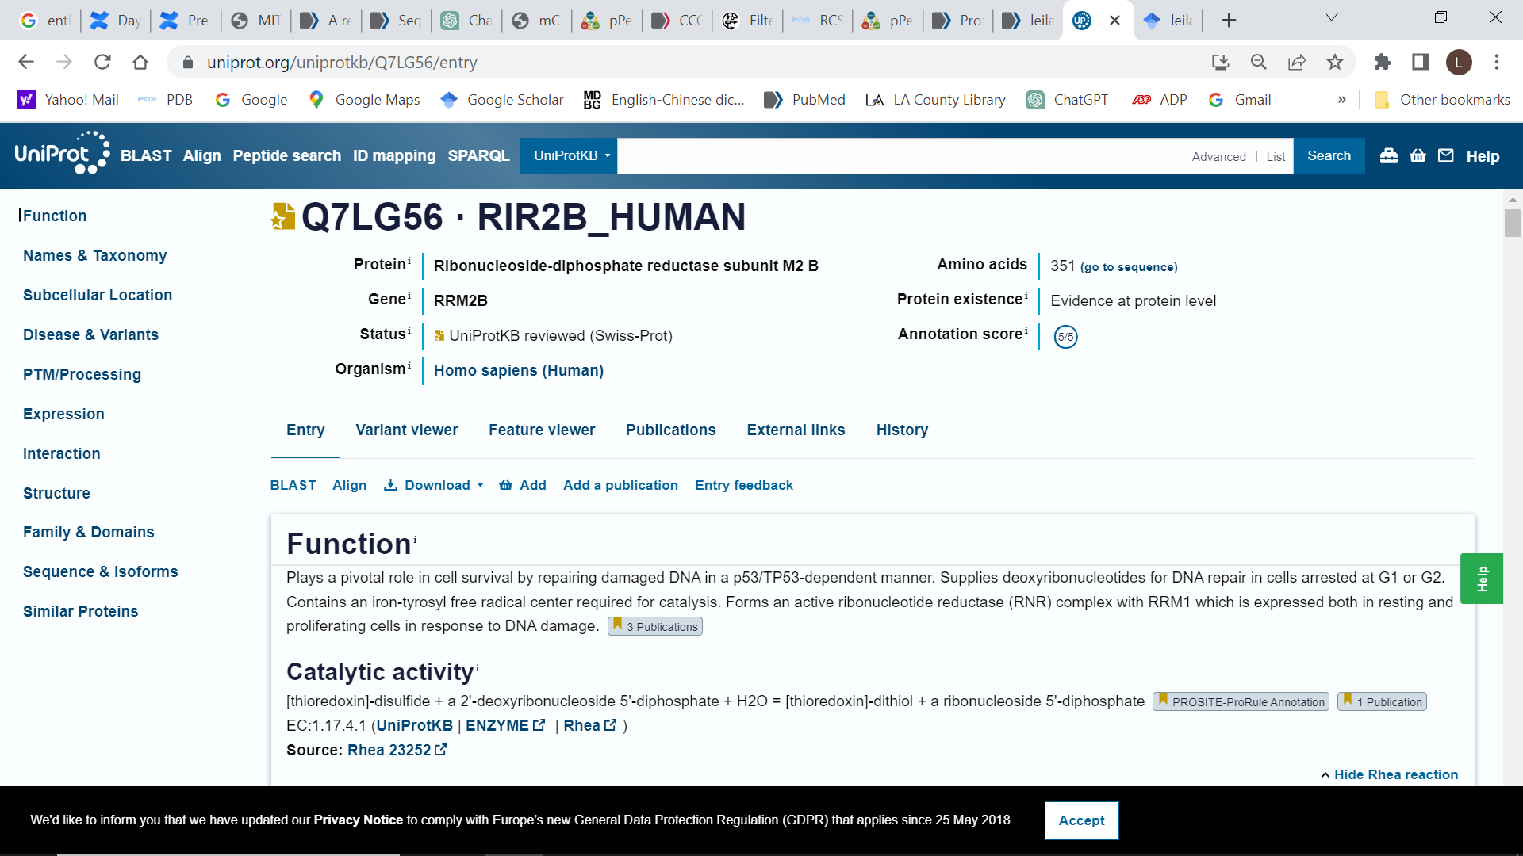

Slide 17
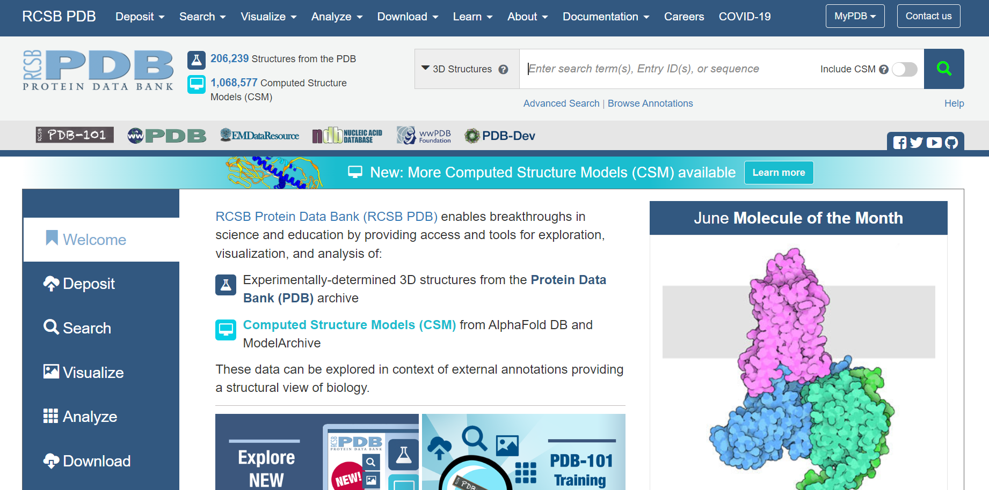
Research Collaboratory for Structural Bioinformatics (RCSB) is a consortium consisting of three institutions: Rutgers University, San Diego Supercomputer Center at University of California, San Diego, and the National Institute of Standards and Technology.
https://www.rcsb.org/

Slide 18
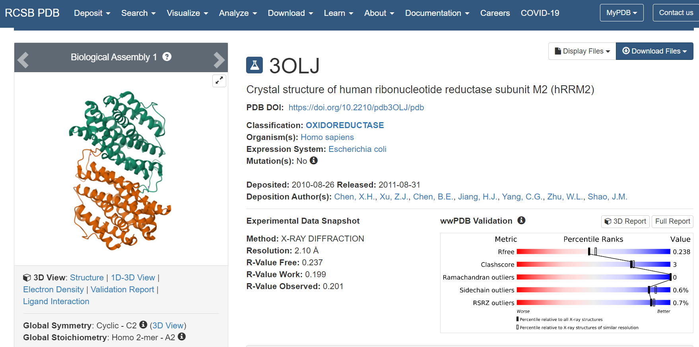
Search for human Ribonucleotide Reductase M2 structure

Slide 19
Homework – Have fun!
Find out the following information regarding Covid-19 virus using NCBI or other resources
What type of virus the Covid19 is?
What is the key protein in Covid19 virus?
Find out the genetic sequence of this protein
Find out the protein sequence of this protein
Find out the protein structure of this protein
What are the differences between delta and omicron variants?
How vaccine works again Covid19?

