Slide 1
SACF Final Presentation
By: Angeline Shy

Slide 2
TABLE OF CONTENTS
01
02
03
MITOCHONDRIAL DISEASE
Ribonucleotide reductase
RRM2B
04
05
DATABASE
Data analysis & organize
MDD, MDS
RNR
RRM2B-MDS, mutations
ClinVar, OMIM, Human genome variation society, UK Biobank Decipher, NIH MedGen
Combine data,
Map mutation to hRRM2B
Notes:
Here is the table of contents what I’m going to talk for today.

Slide 3
01
MITOCHONDRIAL DISEASE
Notes:
Mitochondrial disease

Slide 4
Mitochondrial depletion disorder (MDD)
A pure myopathic form
mutations in TK2, RRM2B
A hepatocerebral syndrome
mutations in DGUOK, MPV17, POLG, PEO1, SULCA2, SULG1
involving a progressive encephalopathy with liver
Notes:
There have many type of mitochondrial disease, one of them is MDD. For MDD, a pure myopathic wil form by mutations in TK2, and RRM2B genes, and a hepatocerabral syndrome will form by mutations in DGUOK, MPV17, POLG, PEO1, SULCA2, SULG1 genes. The Hepatocerebreal syndromes also involving a progressive encephalopathy with liver.

Slide 5
Mitochondrial Depletion Syndrome (MDS)
Rare genetic disorders limit the number of mitochondrial
Associated with defects in mtDNA maintenance
mtDNA depletion
TK2, SUCLA2, SUCLG1, RRM2B, TYMP, DGUOK
Insufficient mtDNA
POLG, C10orf2, MPV17
Notes:
A group of rare genetic disorders that limit the number of mitochondrial inside cells, and also associated with defects in mtDNA maintenance. It caused by mutations in nuclear genes function in dNTP synthesis or mtDNA replication. mtDNA depletion caused by a mutation in genes of TK2, SUCLA2, SUCLG1, RRM2B, TYMP, DGUOK; and insufficient mtDNA is caused by a mutation in genes of POLG, C10orf2, MPV17.

Slide 6
Ribonucleotide reductase (RNR)
02

Slide 7
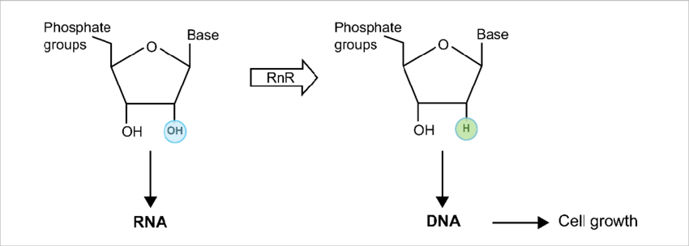
RNR
01
Key Enzyme
02
Convert
03
Building Blocks
Notes:
Ribonucleotide reductase also known as RNR, it is The key enzyme that mediates the synthesis of deoxyribonucleotides. RNR enzyme convert ribonucleotides to deoxyribonucleotides, the building blocks for DNA replication and repair.

Slide 8
RRM2B
03

Slide 9
RRM2B
p53R2 attached to protein called R1 to form RNR
Related MDS
encephalomyopathic form with renal tubulopathy (RRM2B - MDS)
begins in infancy
affect multiple body systems
associated with brain dysfunction combined with muscle weakness
Notes:
RRM2B is the gene provides p53 inducible small subunit for making one piece of RNR protein. To form it, two copies of p53R2 are attached to two copies of another protein called R1. There’s a RRM2B related mitochondrial DNA depletion syndrome called encephalomyopathic form with renal tubulopathy. It begins in infancy and affects multiple body systems. It also associated with brain dysfunction combined with muscle weakness.

Slide 10
RRM2B continue
RRM2B-MDS
hypotonia
failure to thrive
microcephaly
delayed development of motor skills
rolling
sitting
gastrointestinal dysmotility
do not move food through the digestive tract efficiently
swallowing difficulties,
vomiting
diarrhea
contribute to a failure to thrive
develop seizures or hearing loss (not common)
live only into early childhood
Mutation in RRM2B gene
Reduce the amount of RNR
Notes:
Infants with RRM2B-MDS have weak muscle tone and do not grow or gain weight at the expected rate. Many have smaller than normal head size. Because of muscle weakness, affected infants often have difficulty controlling head movements and may experience delays in the development of other motor skills, such as rolling over or sitting up. Some people with RRM2B-MDS have a digestive problem called gastrointestinal dysmotility. For this the muscles and nerves of the digestive system don’t effectively move food through the digestive tract. This disorder can lead to difficulty swallowing, vomiting and diarrhea, and may result in failure to thrive. Less commonly, patients with RRM2B-MDS experience hearing loss, which is caused by nerve damage in the inner ear. And like we said before, it will live into early childhood. And if Mutation happen in RRM2B gene, the amount of RNR will reduce.

Slide 11
04
DATABASE

Slide 12
5 DATABASE
ClinVar
OMIM
Human genome variation society
UK Biobank Decipher
NIH MedGen
Notes:
I used 5 different database in total to make up my data. And These are the five.

Slide 13
05
DATA ANALYSIS
& ORGANIZE

Slide 14
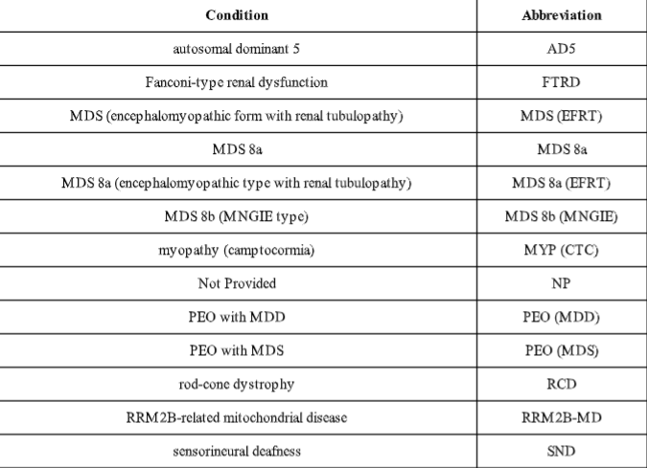
Conditions
Notes:
Here is the the conditions and their abbreviation, we usually will uses abbreviation in the data to make it clean and clear.

Slide 15
Variant Type
single nucleotide variant
Indel
Deletion
Duplication
Notes:
These are the four variant type that shows up in the data, and this is an picture of what will the data looks like after analyzing and organizing it.

Slide 16
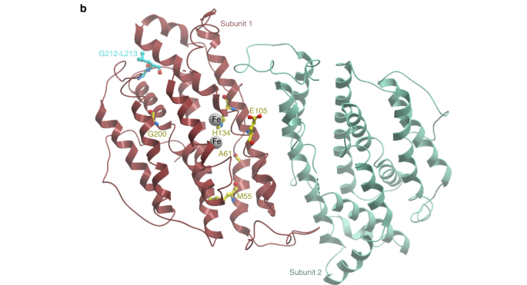
Map the mutations
1 10 20 30 40 50 60 70
hp53R2 MGDPERPEAA GLDQDERSSS DTNESEIKSN EEPLLRKSSR RFVIFPIQYP DIWKMYKQAQ ASFWTAEEVD
hRRM2B V C D Y
71 80 90 100 110 120 130 140
hp53R2 LSKDLPHWNK LKADEKYFIS HILAFFAASD GIVNENLVER FSQEVQVPEA RCFYGFQILI ENVHSEMYSL
hRRM2B P N T

Slide 17
THANKS

